Slide 1
Revolutionizing Interior Design with Augmented Reality in hospitalS
TEAM MEMBERS
MIRUDHULAA M-21MIC0011
SURYA R -21MIC0064
JANANI N - 21MIC0076
BAVADHARANI S-21MIC0095
MONISHA A-21MIC0175
KARTHIK K -21MIC0179

Slide 2
Abstract
The proposed application aims to enhance the process of selecting furniture and interior design components in hospitals. Users will be able to visualize 3D models of furniture or hospital equipment within the hospital using the camera on their mobile devices with the help of Augmented Reality (AR) and fundamental computer graphics techniques.
The application identifies vertical and horizontal planes in real time and determines the appropriate area for placing the 3D models of the selected components. This way hospital administrators and designers need not physically purchase and transport items only to find them unsuitable for their hospital. This project highlights the effective use of AR and computer graphics to solve practical challenges in hospital interior design, improving efficiency and decision making.

Slide 3
INTRODUCTION
Hospital interior design significantly impacts patient well-being and hospital efficiency. Unlike homes and offices, hospitals prioritize patient care, resource efficiency, and smooth workflows for healthcare professionals. Traditional design methods are time-consuming and costly due to space constraints, safety regulations, and manual planning.
This project proposes an augmented reality (AR) solution for hospital interior design, enabling administrators and architects to visualize furniture placements and layouts in real-time. AR allows for accurate representation of hospital beds, medical trolleys, and other equipment, helping avoid costly returns and replacements. Users can experiment with layouts, styles, and color schemes while ensuring compliance with safety and accessibility standards.
By leveraging AR, the project aims to make hospital interior planning more efficient, cost-effective, and user-friendly, ultimately creating safer and more comfortable environments for patients, staff, and visitors.

Slide 4
LITERATURE REVIEW PAPER-1
TITLE | AUTHOR | METHODOLOGY | SUMMARY | ADVANTAGES | DIS- ADVANTAGES
Optimizing Hospital Room Layout to Reduce the Risk of Patient Falls | Sarvenaz Chaeibakhsh, Roya Sabbagh Novin, Tucker Hermans, Andrew Merryweather, Alan Kuntz | Simulated annealing optimization applied to hospital room layouts using fall-risk models and architectural constraints | Optimized room layouts reduce patient fall risk by 41% over random layouts and 18% over traditional layouts using furniture placement, lighting, and patient mobility analysis | Improves patient safety, follows architectural guidelines, and optimizes space usage | High computation time (~7 hours), limited to simulations, no real-time AR visualization

Slide 5
PAPER-2
TITLE | AUTHOR | METHODOLOGY | SUMMARY | ADVANTAGES | DIS- ADVANTAGES
AR Furniture: Integrating Augmented Reality Technology to Enhance Interior Design | Waraporn Viyanon, Thanadon Songsuittipong, Phattarika Piyapaisarn, Suwanun Sudchid | Prototype development using Unity3D, Kudan AR SDK, and 3Ds Max; experiments on tracking and user satisfaction | An Android AR application that allows users to visualize furniture placement in real environments using marker and markerless tracking. Tested for usability, lighting conditions, and tracking accuracy. | Enhances furniture shopping experience, helps in decision-making, allows realistic visualization of products | Issues with light conditions, limited tracking accuracy, and difficulty in troubleshooting errors.

Slide 6
PAPER-3
TITLE | AUTHOR | METHODOLOGY | SUMMARY | ADVANTAGES | DIS- ADVANTAGES
The Impact of Design Factors on User Behavior in a Virtual Hospital Room to Explore Fall Prevention Strategies | Nooshin Seddighi, Ying-Ching Chen, Andrew S. Merryweather, et al. | Experimental study using Augmented Reality (AR) with 10 participants, tracking movement through various hospital room layouts | Explores AR as a tool for assessing fall risks in hospital rooms, examining the effects of door type, bathroom location, and IV pole presence on movement patterns | AR is cost-effective for testing hospital layouts before physical construction; provides insights on fall prevention strategies | Limited participant sample; AR may not fully replicate real-world patient behavior; physical interaction with objects is restricted.

Slide 7
PAPER-4
TITLE | AUTHOR | METHODOLOGY | SUMMARY | ADVANTAGES | DIS- ADVANTAGES
The Therapeutic Impacts of Environmental Design Interventions on Wellness in Clinical Settings: A Narrative Review | Timothy Onosahwo Iyendo, Patrick Chukwuemeke Uwajeh, Ezennia Stephen Ikenna | Narrative review of literature on environmental design in healthcare settings | Examines the role of physical environmental factors in reducing stress, enhancing privacy, and improving overall healthcare quality. Discusses the impact of sound, natural light, ventilation, cleanliness, and sanitation on patient recovery and well-being. | Emphasizes the positive impact of well-designed environments on mental and physical health, supports a holistic healing approach, and identifies key contributors to wellness. | Lacks empirical data, does not comprehensively explore all healing environment factors, and calls for further research on the ecological context in healthcare.

Slide 8
PAPER-5
TITLE | AUTHOR | METHODOLOGY | SUMMARY | ADVANTAGES | DIS- ADVANTAGES
Comparative Analysis of Restorative Interior Design Elements: Screen-Based Versus Virtual Reality Evaluations for Future Medical Treatment Prospects | Alp Tural, Elif Tural | Experimental study using screen-based and virtual reality (VR) evaluations with 35 participants assessing 16 interior settings | Investigates how window views, materials, and ceiling geometry influence restorativeness in mental healthcare settings. VR evaluations showed stronger responses than screen-based ones. | Highlights VR as an effective tool for interior design assessment, supports evidence-based design for mental healthcare | Small sample size, VR effects may vary, long-term impacts not assessed.

Slide 9
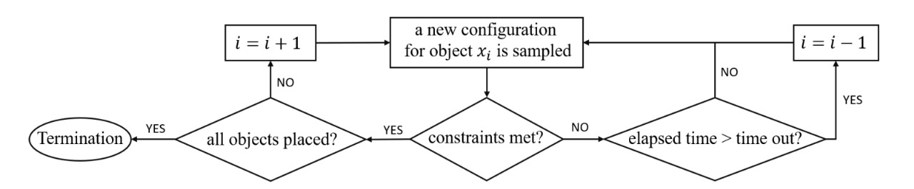
Block diagram

Slide 10
Hardware and Software requirements
HARDWARE REQUIREMENTS:
Smartphone or Tablet with AR capabilities (AR Core for Android)
Camera Sensor for real-time object tracking and spatial recognition
Processor with Graphics Support (e.g., Qualcomm Snapdragon, Apple A-series chips)
PC/Laptop with RAM (for development, at least 4GB for smooth AR rendering, i5processor)

Slide 11
Hardware and Software requirements
SOFTWARE REQUIREMENTS:
Unity 2021+ (Game Engine for AR development)
AR Foundation (Unity package for AR Core/ARKit support)
AR Core SDK (for detecting surfaces & placing objects)
C# (Scripting Language) (for writing interaction logic in Unity)
Blender / Maya (for creating or editing 3D furniture models)
Android Studio (for deploying the app to mobile devices)
GitHub (Optional) (for version control and collaboration)

Slide 12
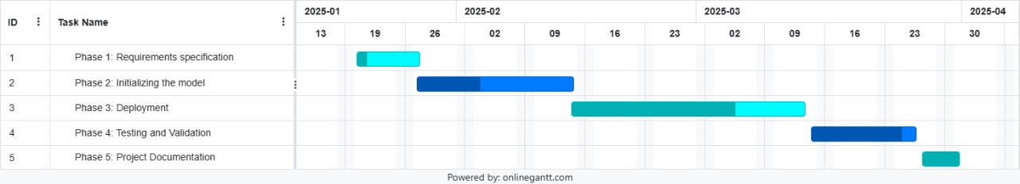
TIME LINE CHART

Slide 13
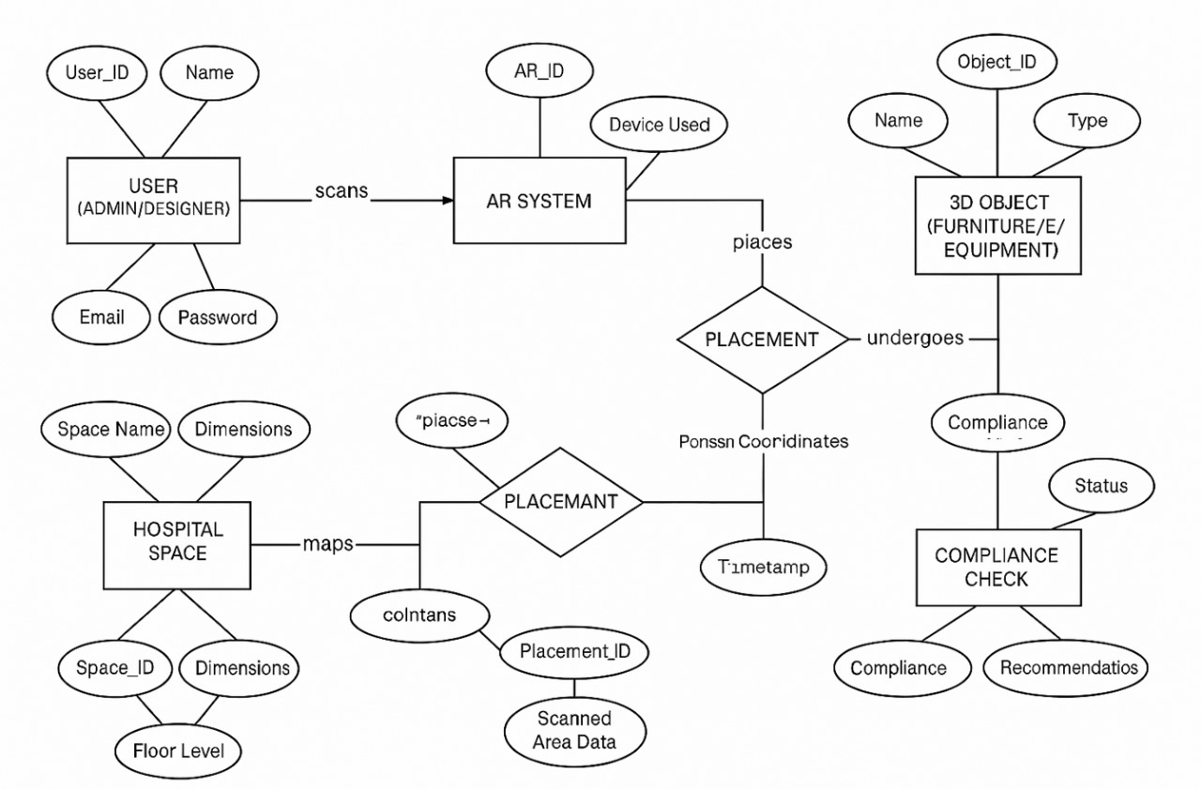
block diagram:

Slide 14
Survey on Existing Systems
Current hospital interior design systems rely heavily on traditional CAD modeling, manual measurements, and static blueprints.
Some existing technologies use 3D modeling software, but they lack real-time visualization in the actual environment.
AR-based solutions have been explored in general interior design but are rarely optimized for hospital-specific needs.

Slide 15
Identified Gaps in Existing Systems
Lack of Real-time Visualization: Traditional planning does not provide instant feedback.
Manual Adjustments: Requires frequent physical changes, increasing costs and time.
Limited Accessibility: Existing tools are complex and not user-friendly for hospital administrators.
No Dynamic Adjustments: Space constraints and patient accessibility are not dynamically considered.

Slide 16
Workflow of Interior Design with AR in Hospitals
Environment Scanning – The AR system scans the hospital room layout.
Object Recognition & Placement – Identifies and places essential hospital equipment.
Adjustment & Alignment – Users can reposition or scale equipment for best fit.
Validation & Compliance Check – Ensures adherence to medical standards.
Finalization & Deployment – Saves the design for future implementation.

Slide 17
1. Environment Scanning
Uses AR Foundation SDK to map hospital spaces in real-time.
Detects available surfaces using depth-sensing technology.
LiDAR or camera-based scanning ensures accurate spatial recognition.
Machine learning models help in identifying walls, floors, and existing structures.

Slide 18
2. Object Recognition & Placement
Hospital furniture and equipment are stored as 3D models in a database.
Users can browse a categorized catalog of hospital beds, IV stands, oxygen tanks, etc.
Each object has metadata like dimensions, materials, and regulatory compliance info.
AR-assisted object placement ensures that items are positioned correctly according to hospital space constraints.

Slide 19
3. Adjustment & Alignment
Objects can be repositioned, scaled, or rotated to fit within designated spaces.
Spatial anchoring allows placed objects to remain fixed in real-world coordinates.
Collision detection algorithms prevent overlapping placements.
Voice and gesture-based controls improve user interaction for precise adjustments.

Slide 20
4. Validation & Compliance Check
The system cross-references hospital safety standards before confirming placements.
Checks include:
Fire safety clearance – Ensures no equipment obstructs emergency exits.
Patient accessibility – Validates wheelchair and stretcher movement paths.
Medical compliance – Confirms proper spacing for medical operations.
AI-powered recommendations suggest optimal layouts based on best practices

Slide 21
5. Finalization & Deployment
Once the design is finalized, a report is generated detailing object placements and specifications.
The system allows exporting design layouts to hospital management software.
Administrators can use AR visualization for stakeholder presentations and approvals.
Future updates could integrate real-time IoT tracking for dynamic space management.

Slide 22
Demonstration
To illustrate the system’s functionality, a test setup was created in a simulated hospital room. The AR interface allowed users to visualize ICU beds, medical carts, and monitoring devices before actual installation. The system successfully positioned hospital equipment without physical trials.

Slide 23
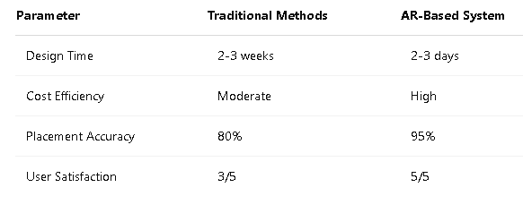
Experimental Results & Analysis

Slide 24
Future Developments:
AI-powered automation for layout suggestions.
Integration with hospital databases for better space management.
Compatibility with VR for immersive walkthroughs.

Slide 25
conclusion
The AR-based interior design application for hospitals addresses critical challenges in selecting and arranging furniture efficiently. By allowing real-time visualization of 3D models, the application reduces unnecessary expenses, minimizes logistical difficulties, and enhances decision-making for hospital administrators and designers. The integration of computer graphics techniques ensures accurate placement and interaction with virtual objects, making the application a practical solution for modern hospital interior design.
This project demonstrates the potential of AR technology in revolutionizing healthcare interior design, ultimately improving functionality, aesthetics, and overall patient care environments.

Slide 26
Thank you

